Slide 1

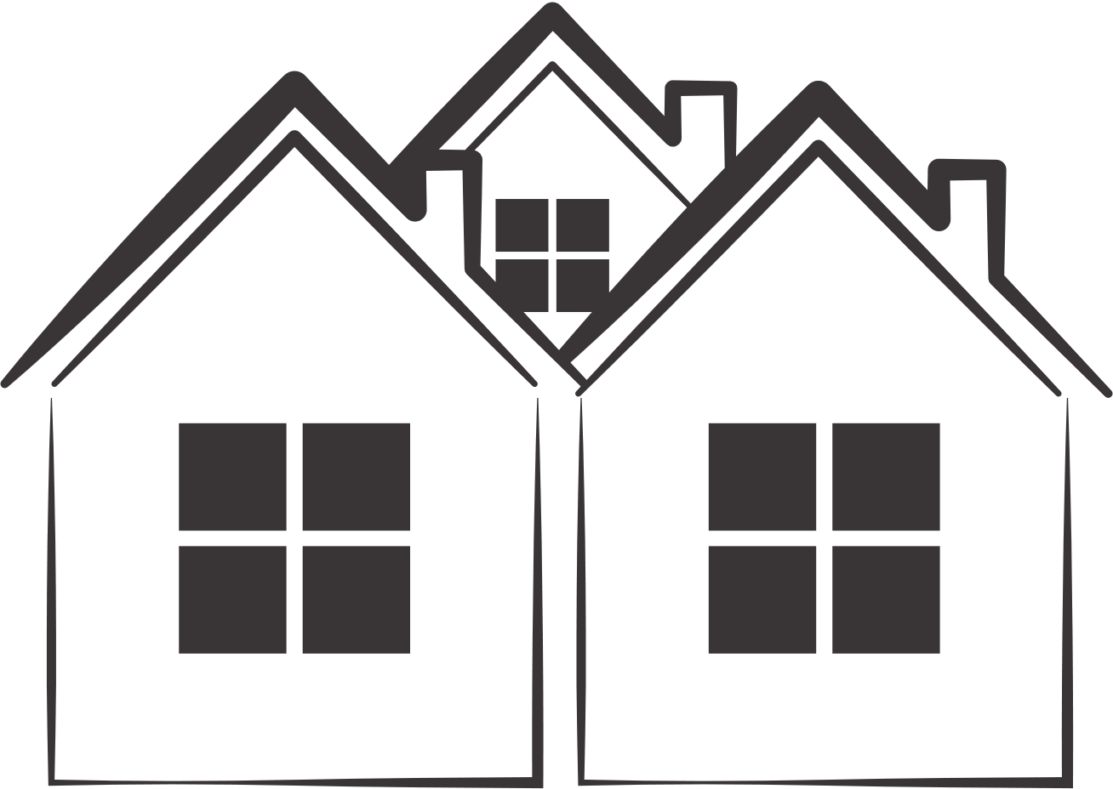
BEIJING PROPERTY INSIGHTS
BY DATA ANALYTICS TEAM
Presented By : Group 28
(Hong Quan, Bryan, Adrian, Wen Shan, Ze Shi, Kar Wai)
Notes:
In the POV that we are presenting to our big boss as the data team.
To be more memorable (and creativity points) we can do a super short skit to set the context

Slide 2
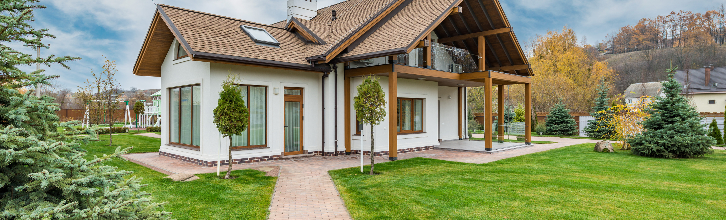
TABLE OF CONTENTS
CONTEXT
DATASET EXPLORATION
DATA ANALYSIS
SUMMARY

Slide 3

ABOUT US
We are the data analytics team of a large real estate organisation venturing to explore and evaluate investment, development, leasing, and mall management opportunities in Beijing.

Slide 4
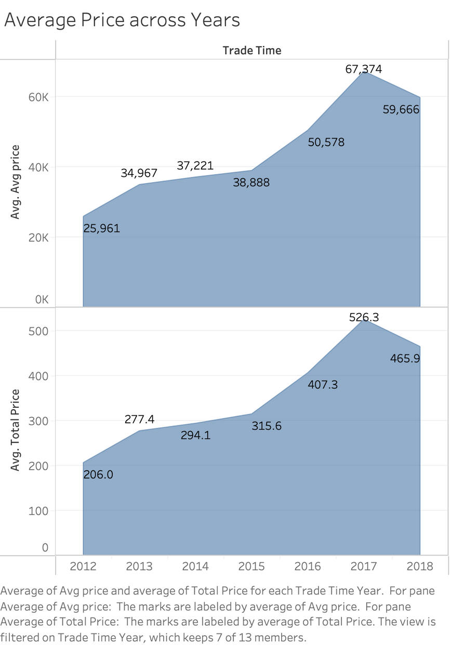
CONTEXT
73% increase
Historical News
In 2015, law introduced to ease foreign investment in real estate market.
Huge boom in demand for property, driving prices up significantly.
67% increase

Slide 5

DATA SET EXPLORATION

Slide 6

UNDERSTANDING DATA SET
Transaction details
Property details
Transaction ID
Date of transaction
Days on Market (DOM)
Followers
Total price (10,000¥)
Price per m^2 (¥)
Property url
Size (m^2)
Community ID
Community Population
Date of Construction
District (Generated)
Longitude
Latitude
Subway nearby (Yes/No)
Has Elevator (Yes/No)
Five years property (Yes/No)
Building Type
1 — Tower
2 — Bungalow
3 — Hybrid Plate/Tower
4 — Plate
Building Structure
Unknown
Mixed
Brick & Wood
Brick & Concrete
Steel
Steel-Concrete
Renovation Condition
1 — Other
2 — Rough
3 — Simple
4 — Refined Decor
No. of living rooms
No. of bedrooms
No. of kitchens
No. of bathrooms
Floor
Low
Medium
High
Data from : bj.lianjia.com
Total Columns : 25
Total Property Transactions: 318851

Slide 7
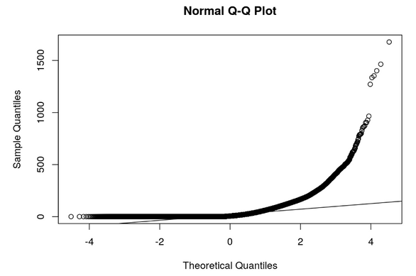
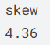
DATA PREPERATION
Missing values
Changes on Total Transactions
Rooms (livingroom, bathroom, drawingroom, kitchen)
NAs : 32
Removed due to insignificant amount of data (0.0001%)
318,851
316,448
Community Average
NAs : 463
Removed due to insignificant amount of data (0.1%)
Data Manipulation
DOM
NAs: 157,977 (49.7%)
Replaced NAs with median
Reason: Data positively Skewed ( 4.36 )
Building Type
NAs : 2021
Removed due to insignificant amount of data (0.6%)

Slide 8
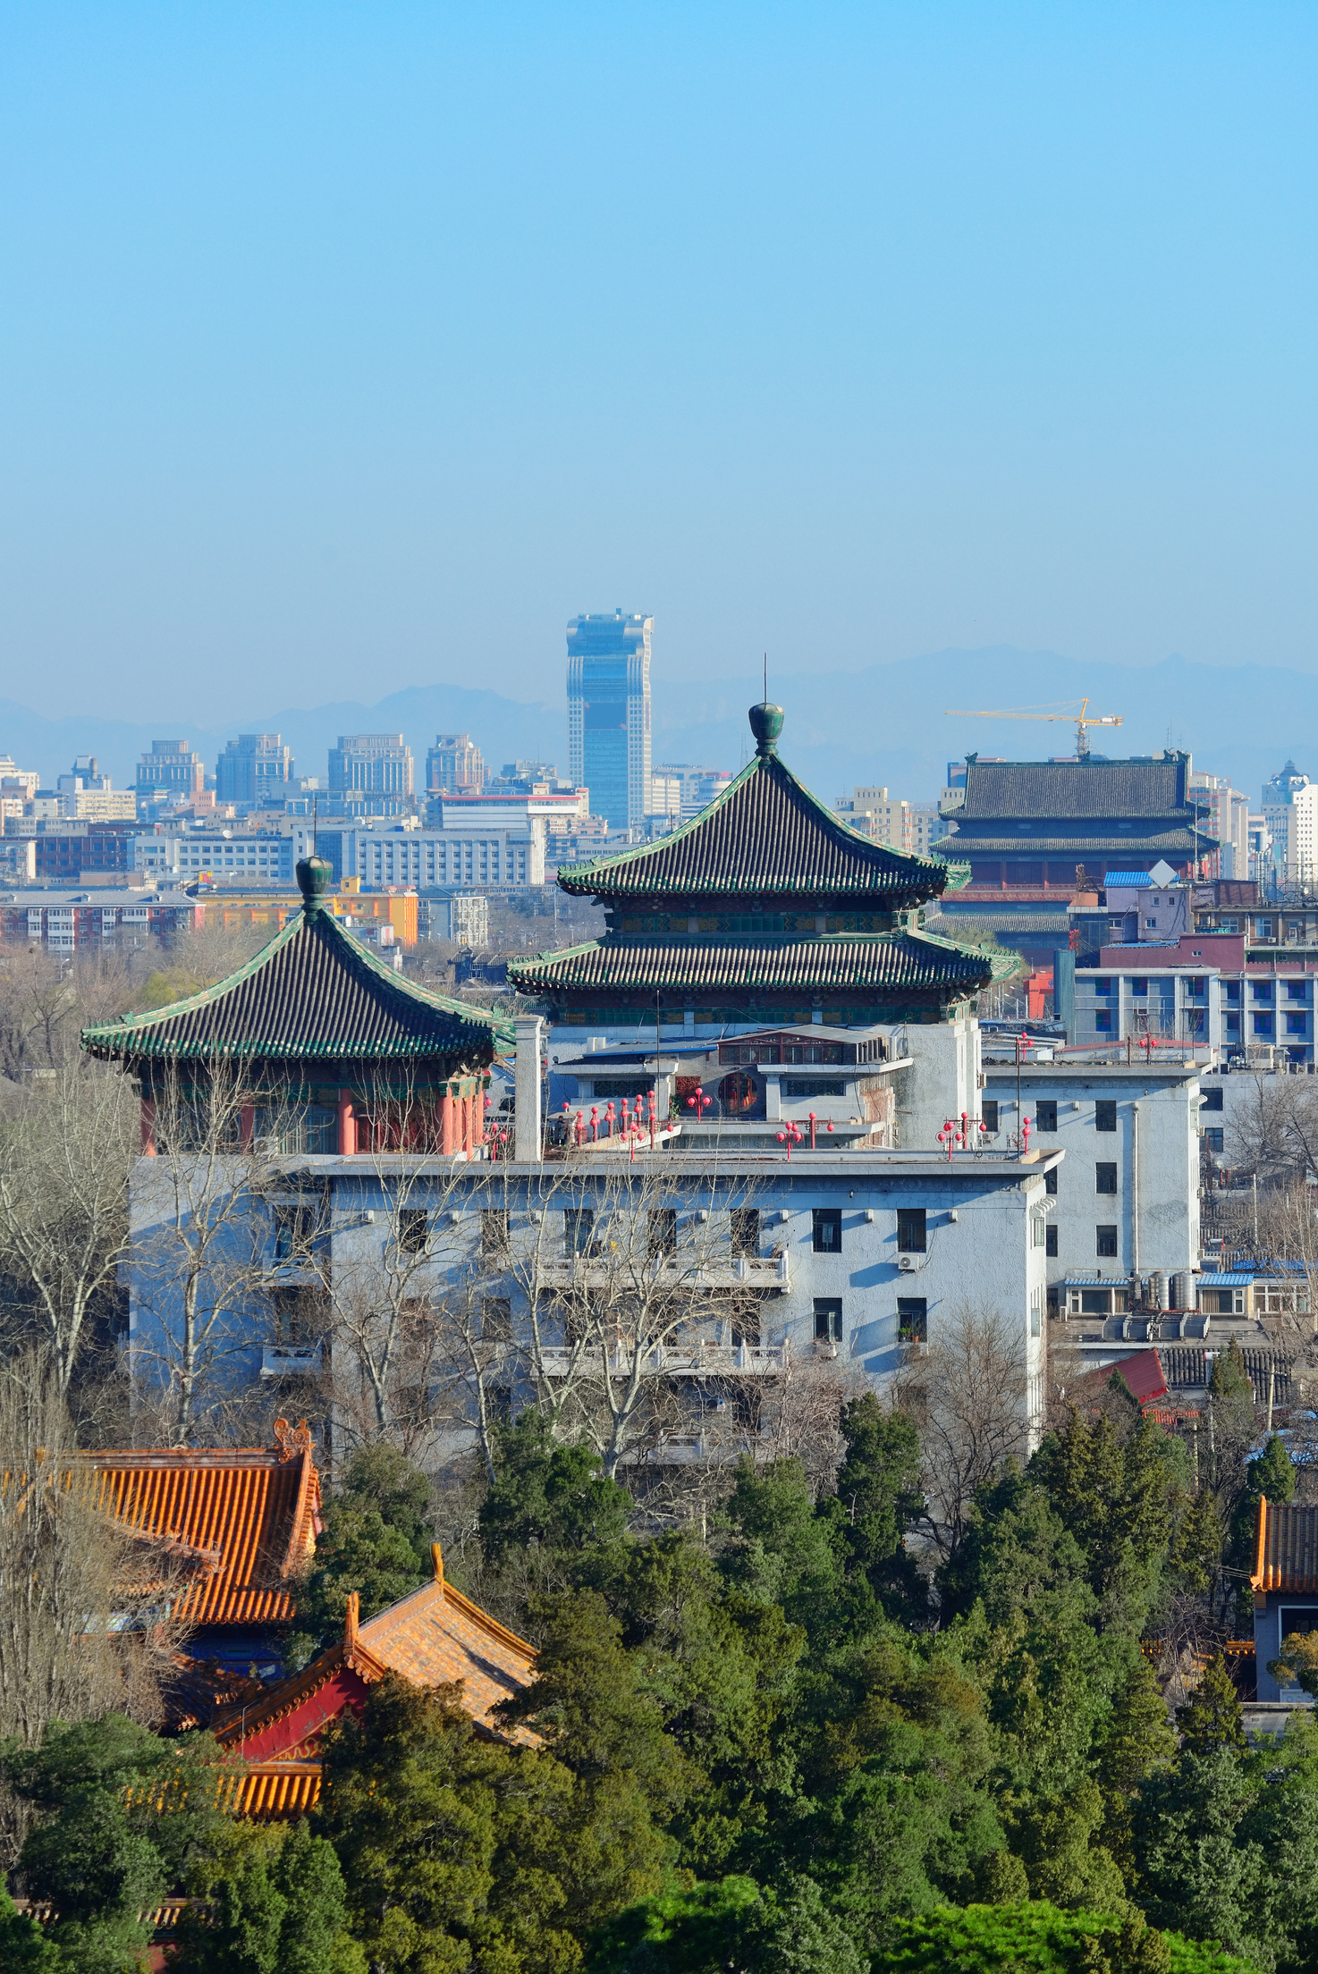
Assumptions
Renovation condition: “Other” = Unrenovated
We would assume that we are in the second quarter of 2018 and only have knowledge of the property market in China until quarter 1 2018

Slide 9

QUESTION 1
LEVEL 1
How should we invest in properties in Beijing?

Slide 10

QUESTION 1 LEVEL 2
How do the attributes of each district affect property prices in Beijing?

Slide 11
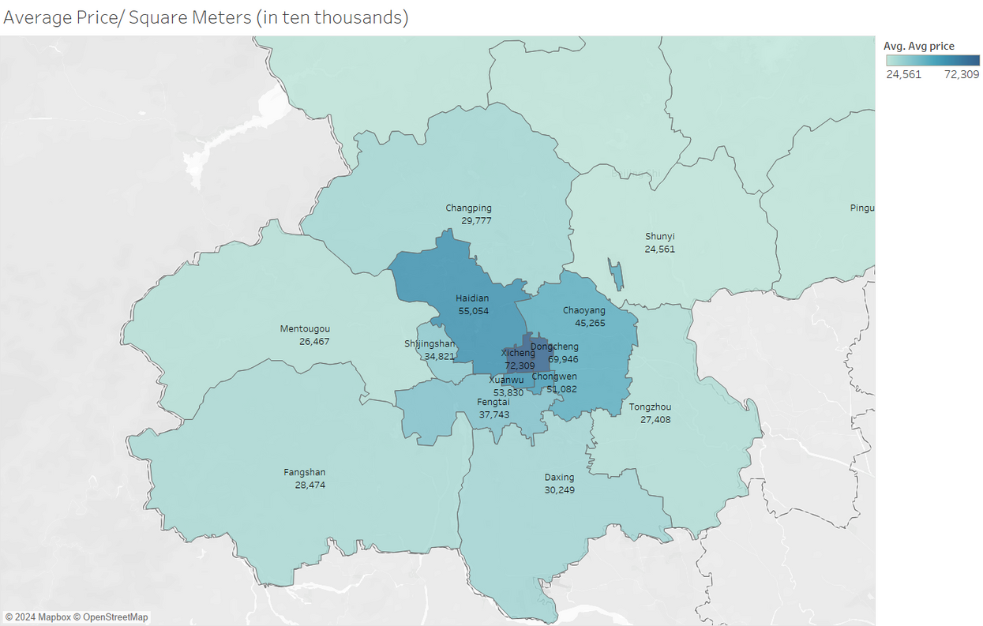
INSIGHT 1
Choropleth maps of Average price/m^2 in each district
Observation:
The property prices in the central area are higher
The property prices on the outskirts of Beijing are relatively lower

Slide 12

QUESTION 1 LEVEL 3
What are the factors affecting property prices in each district?

Slide 13
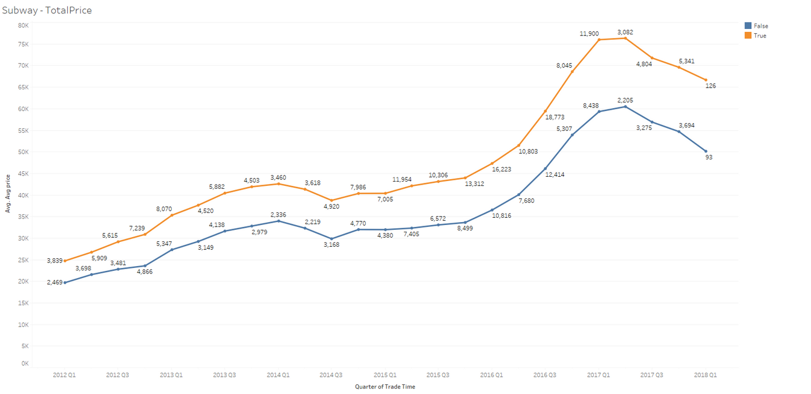
INSIGHT 1
Line chart of the trend of properties with and without access to subway stations
Observation
Listings that have accessibility to subway services have been priced higher
The trend has been consistent for the past 5 years
Listings near subway vs Average price per square metre

Slide 14
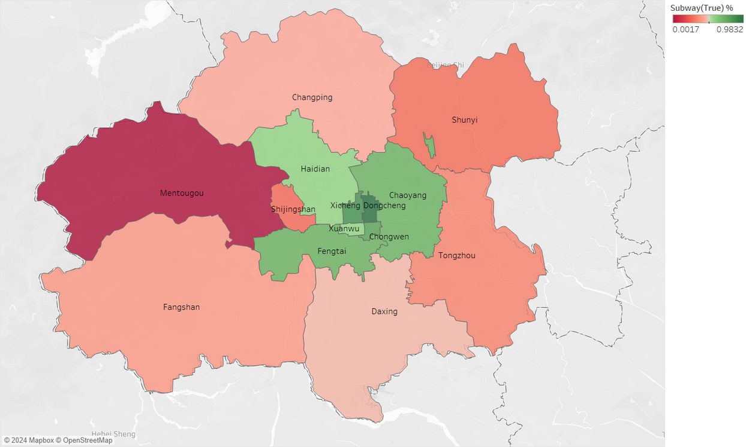
INSIGHT 2
Choropleth maps of percentage of listings with access to subway stations
Observation
Districts with higher percentages of listings with subway services are closer to the middle of Beijing
Districts at the Outskirts have proportionally lower listings with subway services

Slide 15
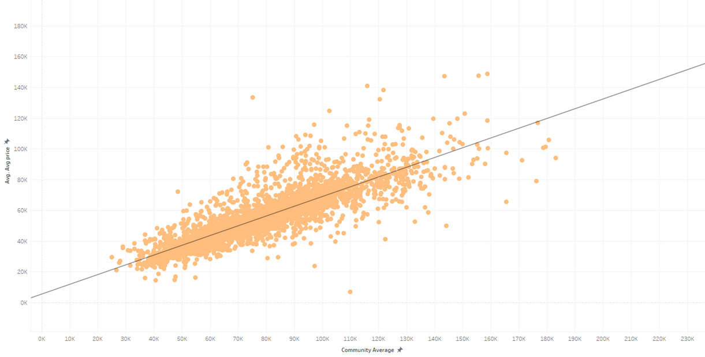
INSIGHT 3
Scatter plot of the average price per square metre to the community average
Observations
Positive correlation between the average price per square metre and average number of people living in the community
Consistency in the dots plotted in the scatter plot.
Average Price vs Community Average

Slide 16
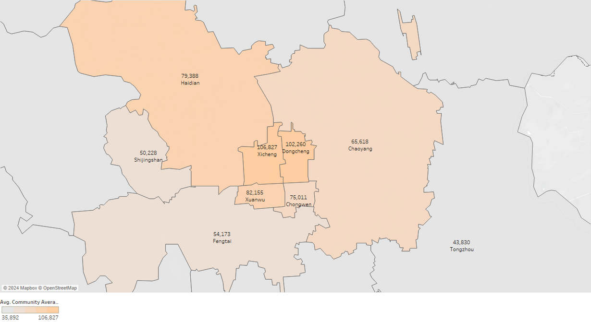
INSIGHT 4
Choropleth map of community averages residing in each district
Observations
Xicheng and Dongcheng are the most populated among the districts
Chongwen is not as populated despite being close to the business district

Slide 17
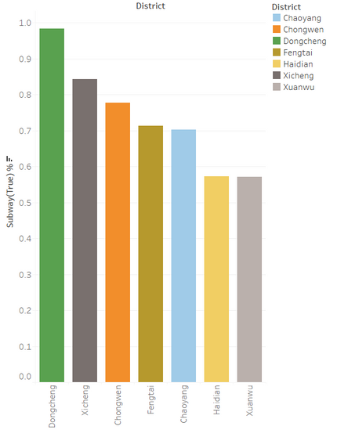
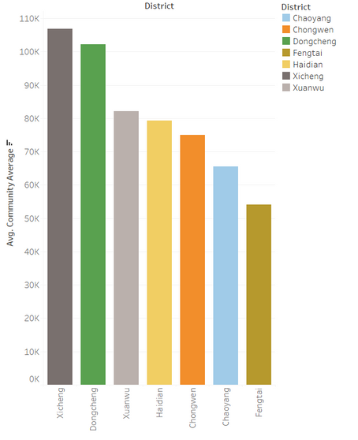
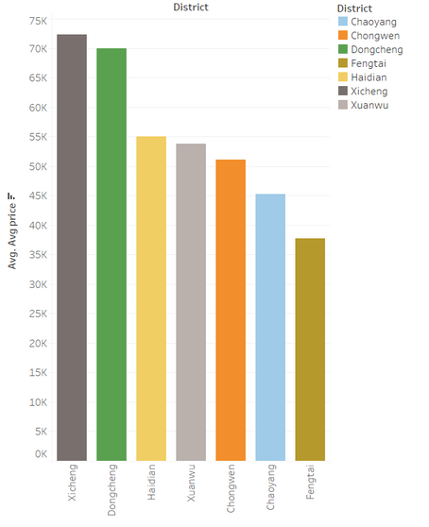
RECOMMENDATION
Bar Charts of the chosen 7 districts
Focus: Chongwen
High Subway Accessibility: Third highest among the 7 districts.
Low Community Average: Ranks 5th in community average.
Low price/square metre: Third lowest compared to the other districts
Undervalued Position: Chongwen is undervalued, especially considering its proximity to the central area.
Subway %
Community Average
Price/Sqm
Notes:
In terms of Subway accessibility, Chongwen has shown to have the third-highest percentage of listings with subway access. Which should have garnered a higher price per square metre
Furthermore, Chongwen has a low community average compared to the 4 districts in the main central business area of Beijing. Chongwen has been shown to have the lowest community average compared to the other 3 central business districts of Beijing.
Despite these factors, Chongwen still ranks 5th in terms of average price per square metre among the 7 districts in Beijing. This could be an important indicator that Chongwen has been undervalued and could valued at higher prices.

Slide 18

QUESTION 2
LEVEL 2
How do housing prices change over time?

Slide 19
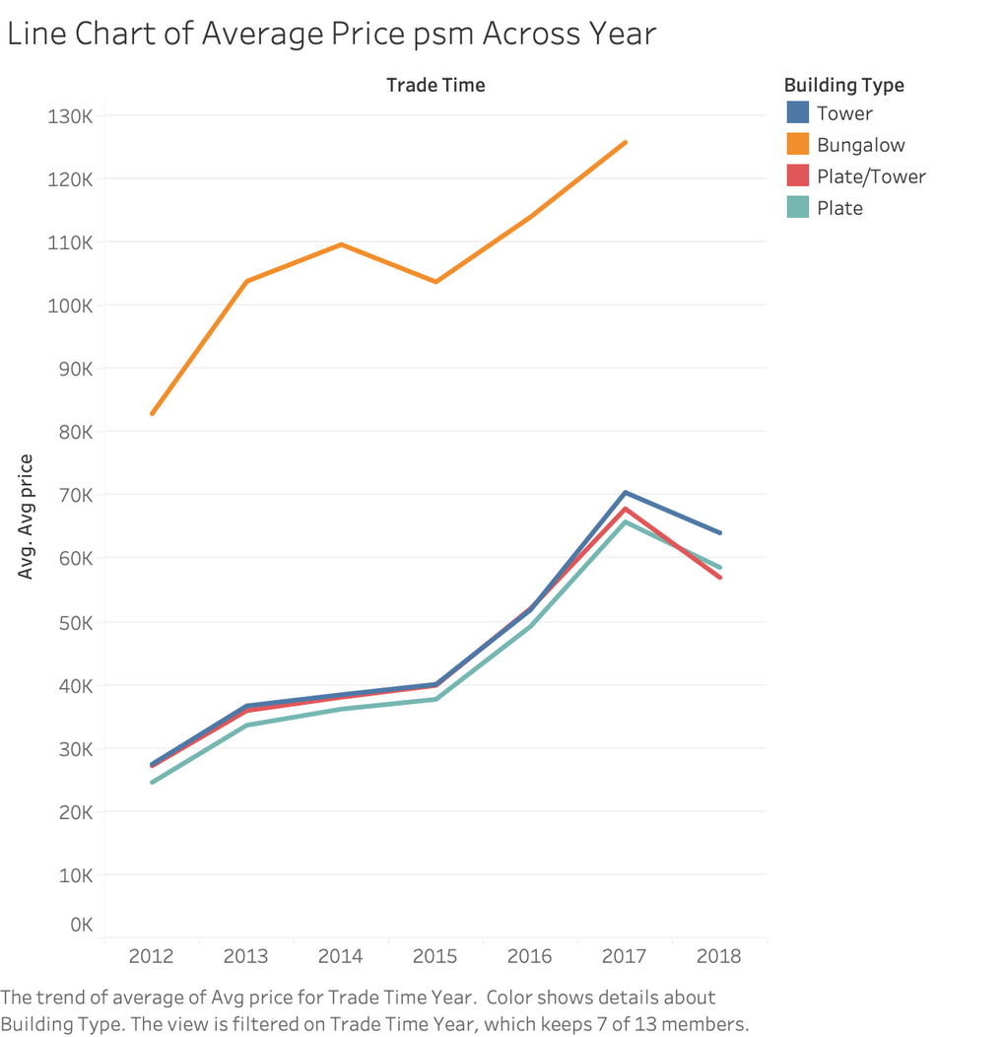
INSIGHT 1
Observation:
Average property prices per square metre show a general upward trend from 2012 to 2017 across all building categories
The average property prices for towers, plates and combination of the two exhibit a slight decrease from 2017 to 2018

Slide 20
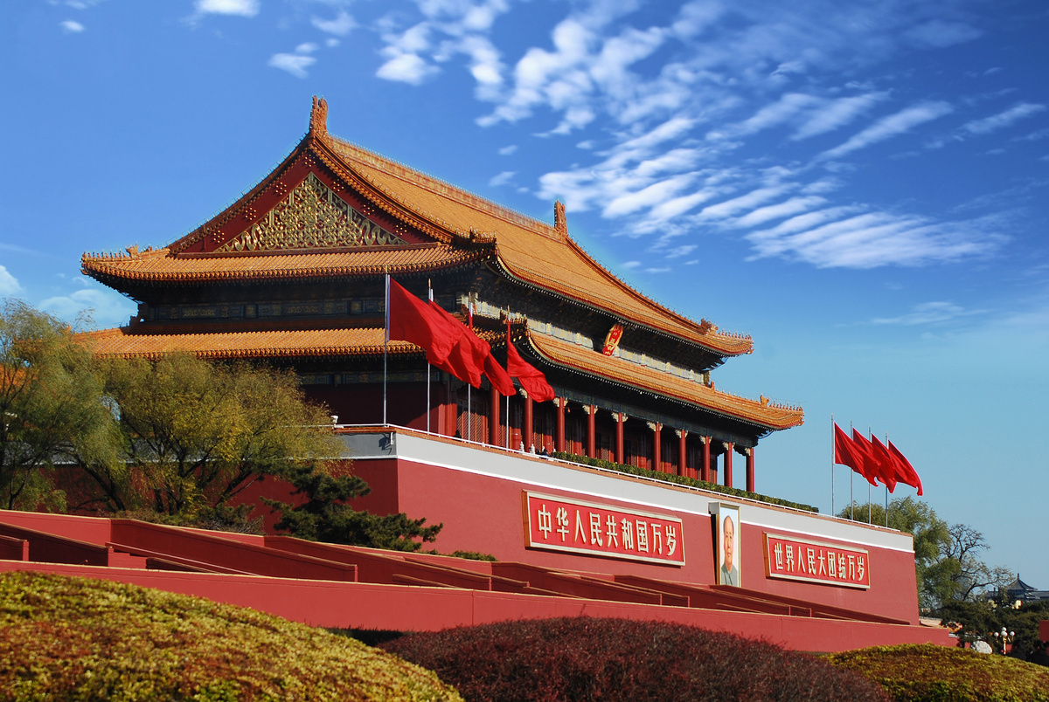
QUESTION 2
LEVEL 3
How does the consumer’s preference change over time?

Slide 21
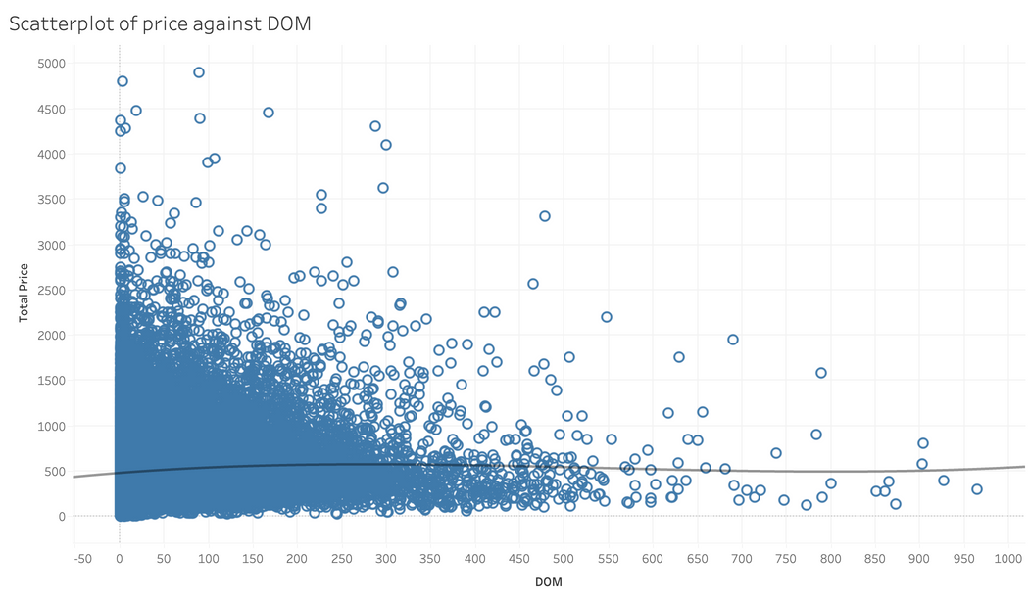
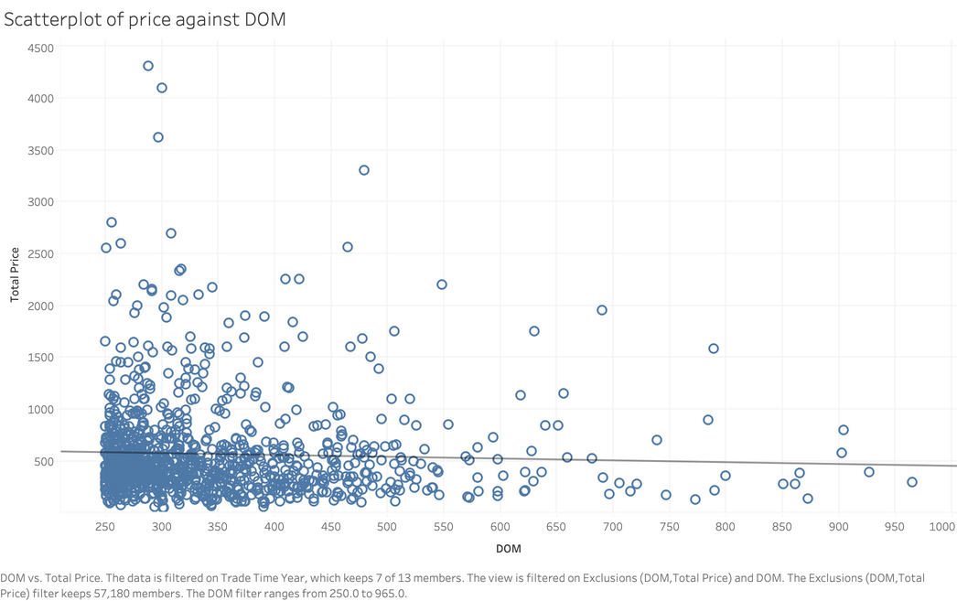
Before filter (All DOMs):
INSIGHT 1
Observation:
Even though there is an overall positive correlation between price and DOM (before filter), there appears to be a trend where the property prices decrease with longer DOM (>250)
After filtering out DOMs that are below 250, we observe a negative correlation between price and DOM
There is high variability in early DOM, which suggests that properties that are listed recently can sell at a higher range of price
After filter (DOMs above 250):
negative correlation: -0.175

Slide 22
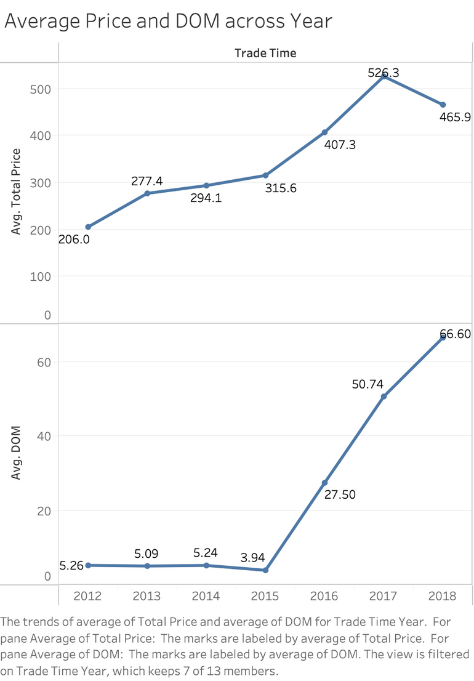
INSIGHT 2
Link between DOM and Property Price
The average property prices in Beijing increase steadily from 2012 to 2015 before showing a sharper increase from 2015 to 2017
Similar trend is observed for the average DOM against Year graph, where the average DOM remains mostly unchanged until 2015, and skyrocketed afterwards

Slide 23
INSIGHT 2
Possible reasons for link between DOM and Property Price
As property prices increase, consumers take a longer time to contemplate their purchasing decisions, which might lead to the high DOM
A prolonged DOM can sometimes be linked with less desirability, as many might presume there are issues with the property
Might have decrease in consumer confidence in the Beijing real estate market in recent years
(Opendoor, 2022)

Slide 24
RECOMMENDATION
Key Recommendation:
To keep the prices of the properties competitive, the prime time to sell the properties is within the first 250 days of listing
Properties that do not sell well can be considered for relisting or price reduction

Slide 25

QUESTION 2
LEVEL 3
When is the most opportune time to invest in the property market?

Slide 26
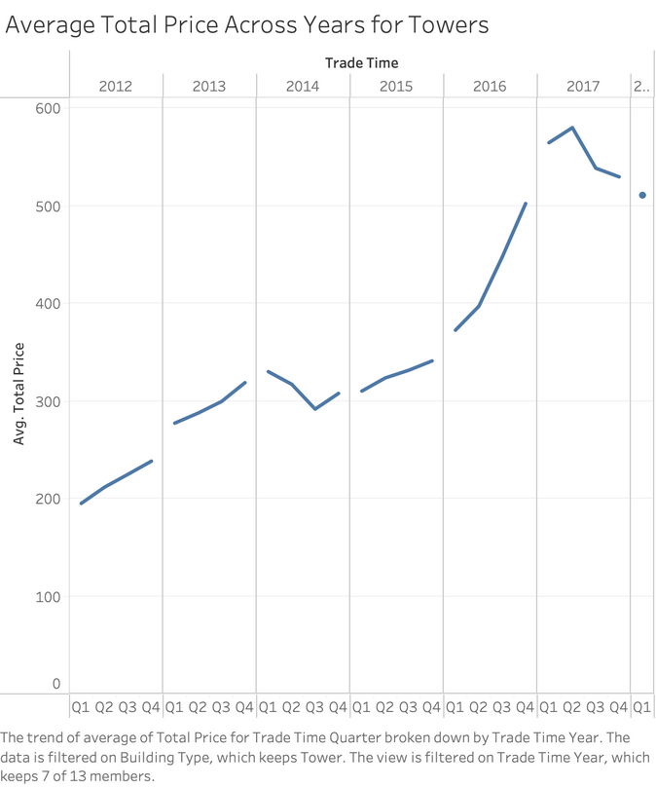
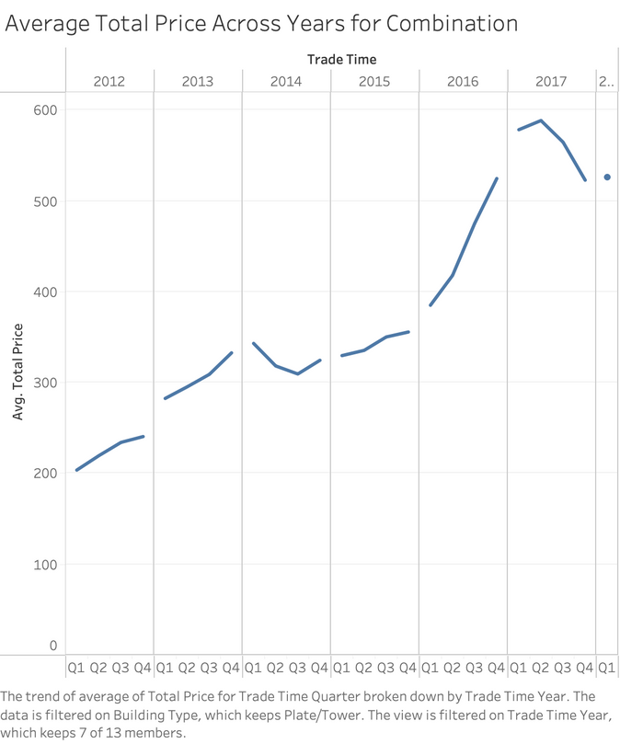
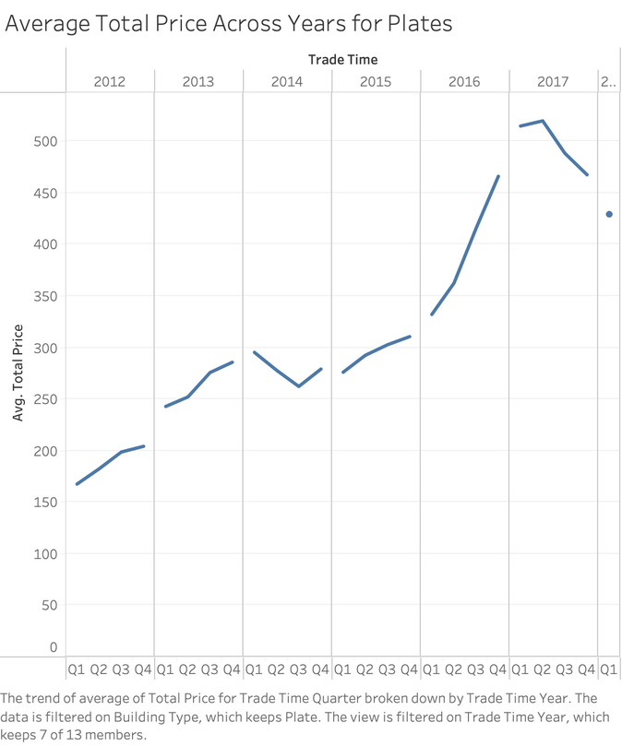
INSIGHT 1
Prices of properties across towers, combinations, and plates generally follow a consistent upward trend across the years from 2012 to 2018
Generally, the prices in Q1 tend to be higher than those in the previous year’s Q4

Slide 27
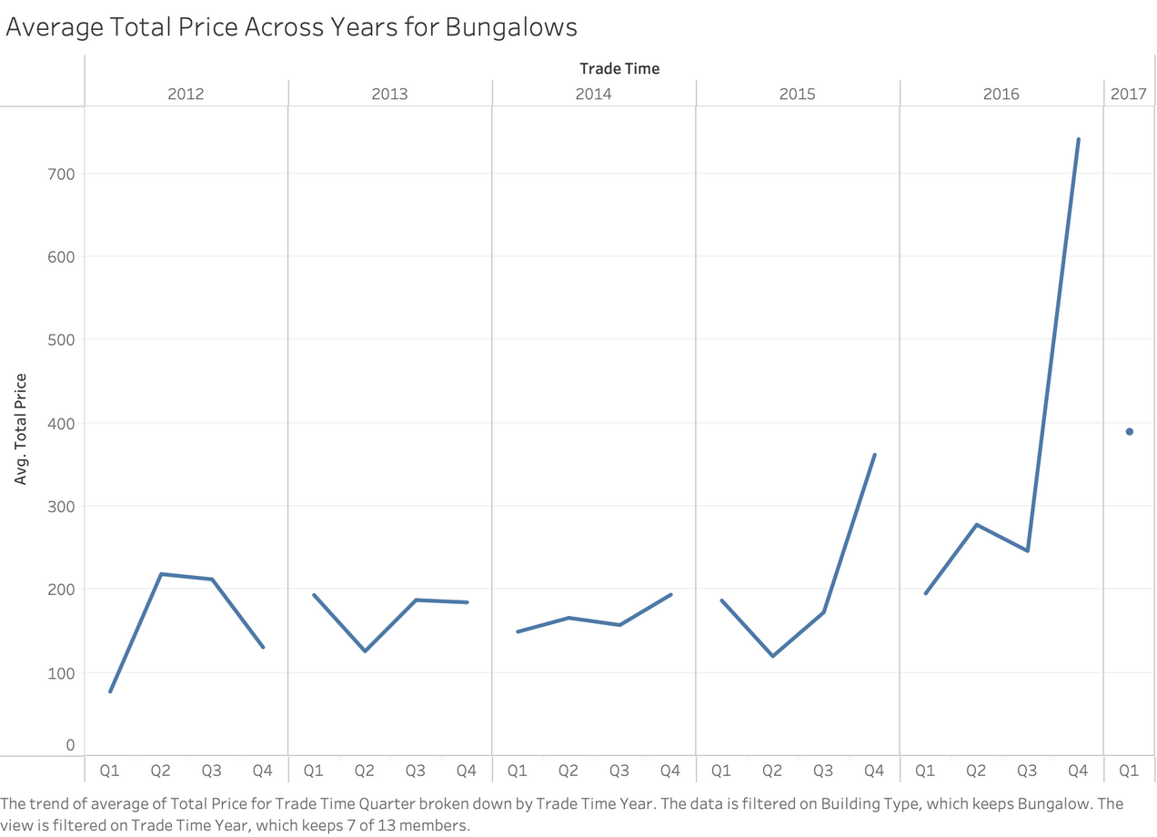
INSIGHT 2
From 2012 to 2017, there is a general upward trend in prices of bungalows
Each year’s Q1 average price appears to be lower than the previous year’s Q4 average price, other than between 2012 and 2013

Slide 28
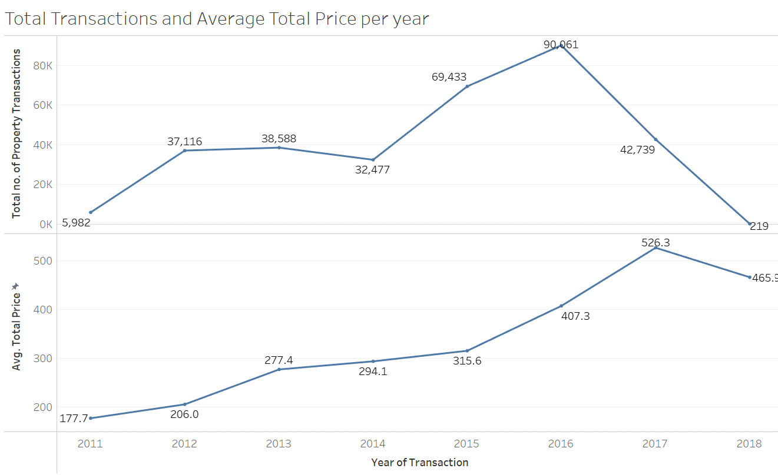
INSIGHT 2
In 2016, Municipal authorities lifted property restrictions on foreigners and overseas Chinese, removing the need for foreigners to have at least 1 year work experience in the city before purchasing property there
Correspondingly, total number of transactions also peaked that same year, followed by the average price of properties peaking the next year in 2017

Slide 29
RECOMMENDATION
Key Recommendation:
For towers, combinations, and plates, strategic buying in Q4 when prices typically dip, and selling in Q1 when prices typically rise is advised
Conversely, for bungalows, it is advisable to buy in Q1 when the prices are lower and sell in Q4 when prices typically peak

Slide 30

QUESTION 3 LEVEL 2
What are the factors affecting number of followers for each property in Beijing?

Slide 31
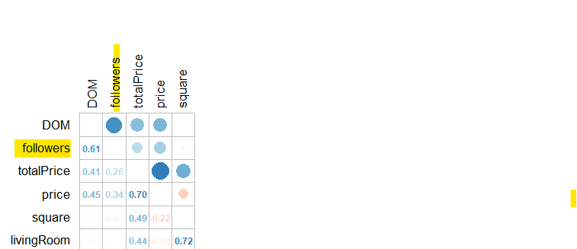
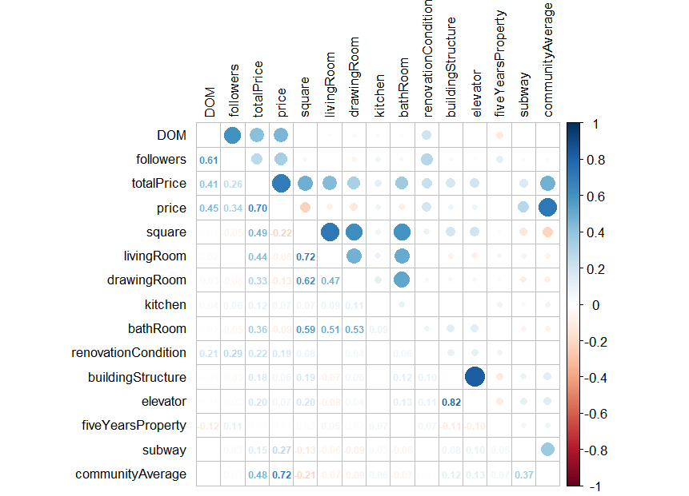
INSIGHT 1
Correlation Matrix of Numeric Variables
Highest correlation between followers and DOM (which is logical)
r = 0.34 between followers and price per square meters

Slide 32
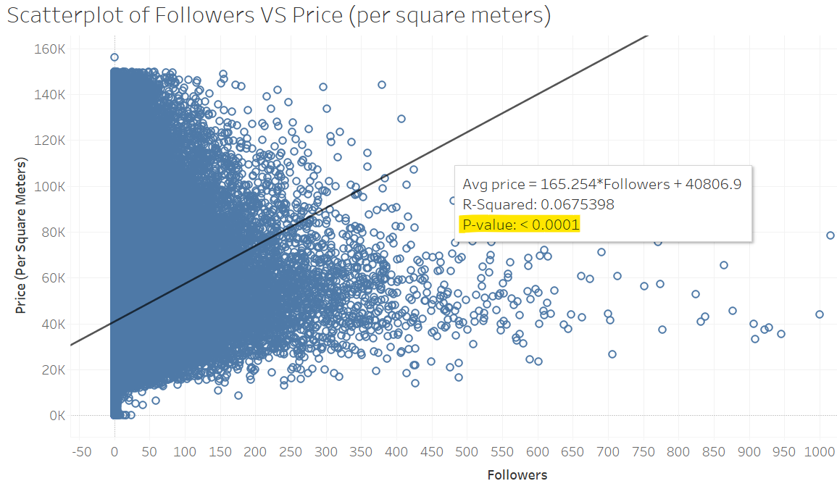
INSIGHT 1
The more followers, the higher the price per square meters sold (p-value <0.05)
Look at categorical variables given low correlation with numerical variables such as living room, bathroom, drawing room kitchen etc with follower count

Slide 33
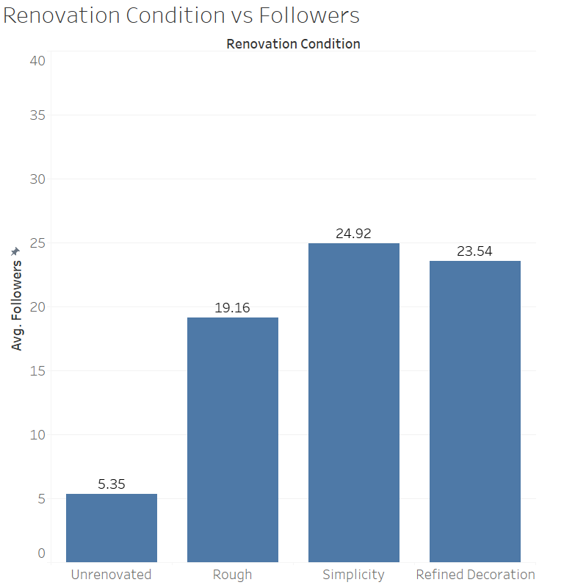
INSIGHT 2
Unrenovated properties -> fewer followers on average
Due to the additional cost of renovation compared to buying a renovated property, regardless the condition

Slide 34
RECOMMENDATIONS
Key recommendations:
Purchase renovated properties for investment instead of unrenovated ones to save cost and draw more buyers’ attention
Conduct a consumer perception survey to understand further motivators in deciding to “follow” a property listing besides the variables in the dataset

Slide 35

LIMITATION
POTENTIAL CONFOUNDERS
Environmental Factors:
Nearby environmental conditions such as pollution levels can influence property values
Demographic Factors:
Characteristics eg income level, and cultural diversity of the local population can impact property demand and prices
Who affects who?

Slide 36

SUMMARY
Level 1 question: How should we invest in the property market of Beijing?

Slide 37
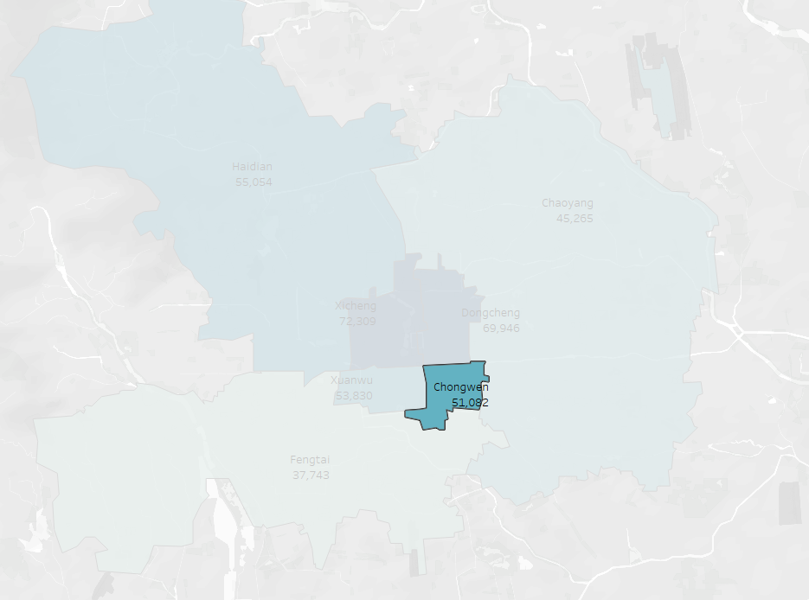
QUESTION 1 SUMMARY
Level 2: How do the attributes of each district affect property prices in Beijing?
Focus on Chongwen
High percentage of subway listings
Low in price per square meter
Despite the low community Average
Chongwen average price per square metre

Slide 38
QUESTION 2 SUMMARY
Level 2: How do housing prices change over time?
Gradual increase over the years, all types of buildings follow the trend
Slight decrease from 2017 to 2018
Sharp increase when policy was announced
Level 3: How does the consumer’s preference change over time?
The prime time to sell a property is within 250 active days on market
Prices tend to fall if the property has been listed for too long
Level 3: When is the most opportune time to invest in the property market
Buy in Q4, Sell in Q1 to reduce holding time and risk of fluctuations
Exception for bungalows, buy in Q1 and sell in Q4 to maximise profit
Respond quickly to property stimulus measures

Slide 39
QUESTION 3 SUMMARY
Level 2: What are the factors affecting the follower count of Beijing properties?
Conduct surveys to gain better insights on what makes consumers want to ‘follow’ a property
Invest by entering the market with renovated properties that are larger in square area to reduce costs and attract more buyers attention

Slide 40
OVERALL SUMMARY
Location: Chongwen
Time: Buy Q1 sell Q4, optimally within 250 days of listing the property (Bungalows exception buy Q4 sell Q1)
Type/Condition: Type insignificant as all follow the same trend of price increase Condition - choose renovated properties over unrenovated ones

Slide 41
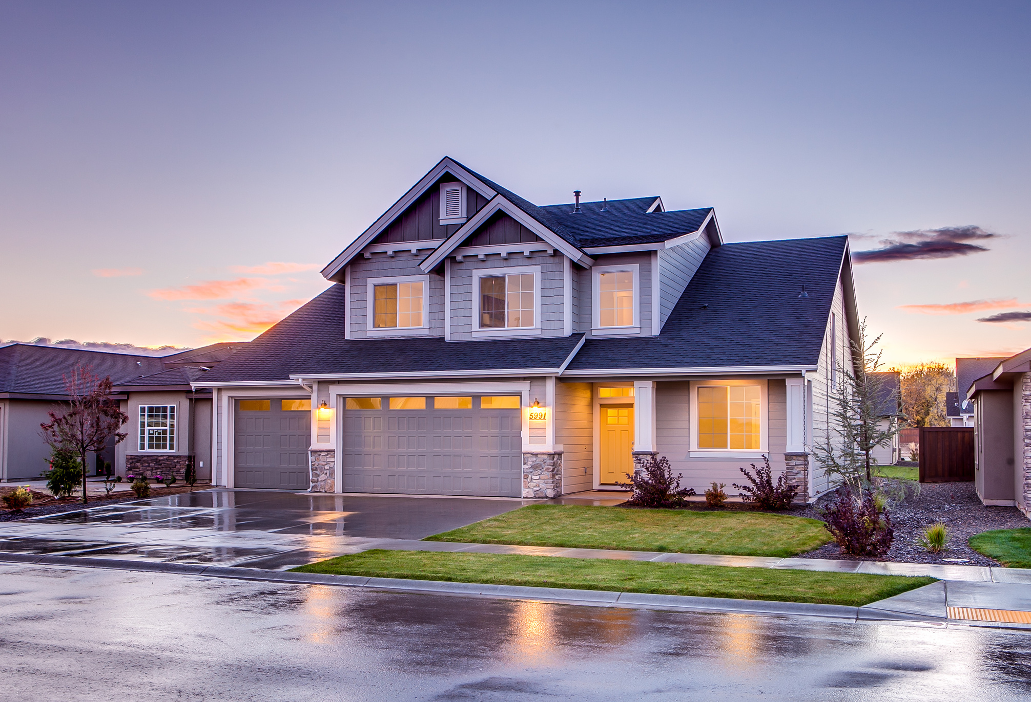
Thank You!

Slide 42
APPENDIX -
BUSINESS QUESTIONS
How should we invest in properties in Beijing?
How do the attributes of each district affect property prices in Beijing
What are the factors affecting property prices in each district?
How do housing prices change over time?
How does the consumer’s preference change over time?
When is the most opportune time to invest in the property market?
What are the factors affecting number of followers for each property in Beijing?

